Slide 1

Loan Default Project
By Shahruk Saeed
Notes:
Introduce yourself

Slide 2


Problem Statement
Using Financial data (https://www.kaggle.com/datasets/yasserh/loan-default-dataset) to predict whether a person will default on a loan or not
This dataset contains 149,000 rows with 34 features
Some of the features included are loan limit, gender, loan type, approved in advanced, credit score, loan amount and term.
The target variable is Status with 0 meaning non-default and 1 meaning defaulted
Notes:
The goal of my project is to …
The dataset ill be using…
Banks take 20% loss on loan amount
These losses can add up
On the next slide ill be giving a brief overview of the data

Slide 3
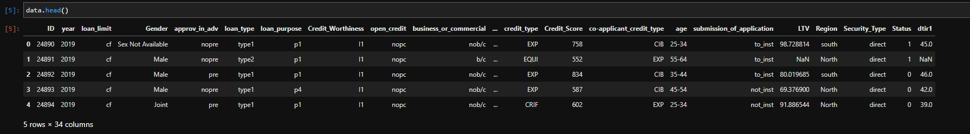
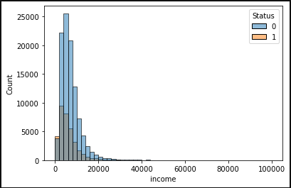
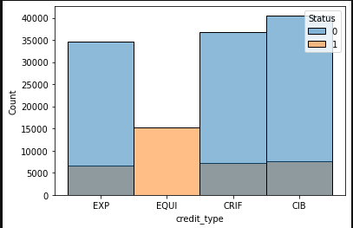
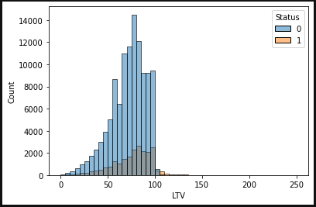
Data( Statistics and First View) add for important features boxplots
First 5 rows:
Distribution:
Notes:
The point of this slide is to get is to take a first look a the data and get a feel for what's in it or see if anything pokes out at us
Also talk about how the second graph could provide a lot information to model for predicting defaulters

Slide 4
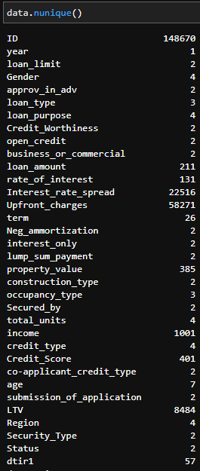
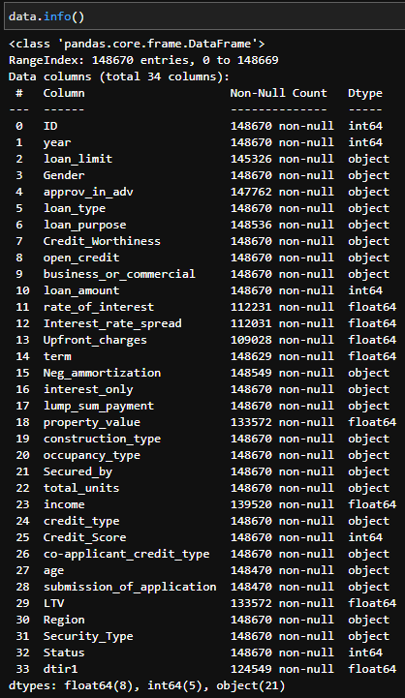
Data ( Null and Unique Values)
22 Categorical Variables
12 Numeric Variables
Columns with most missing data are:
Rate of interest
Interest rate spread
Upfront charges
Highest percentage of data missing in a row is 26%
Notes:
The point of this slide is to figure out what types of variables we’re working with and ones we should investigate

Slide 5
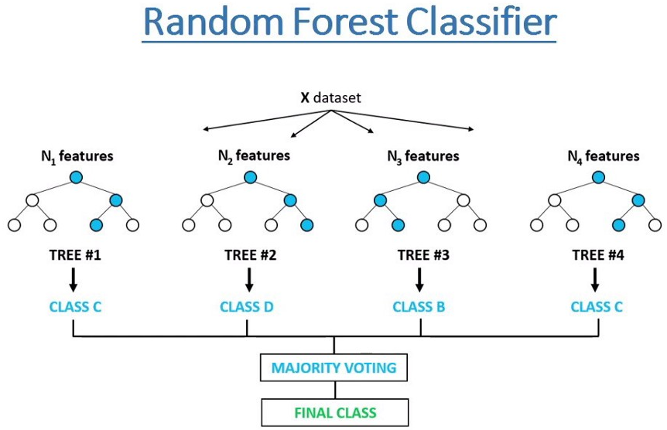
ML Algorithm
The ML algorithm I will be using is a random forest classifier
Some reasons for using it over other models
Less data preparation
Handles larger data well
Interpretability
Good at generalizing
Notes:
the random forest works by having many trees trained on small random portions of the dataset these trees all predict a class and the class that’s predicted the most is chosen as the final prediction
Less data preparation need for example one hot encoding not needed

Slide 6




Method
Data Exploration
Data Preparation
Model Prep and Training
Tuning and Results
Exploring the data to observe relationships
prepped the data for model by :
Formatting the columns
Filling in missing values using MICE
Fixing incorrect data types
splitting data into 70/30 train and test by random sampling
Training the base model
Tuning the model and assessing performance
Notes:
The point of this slide is to show the workflow I used throughout this project

Slide 7
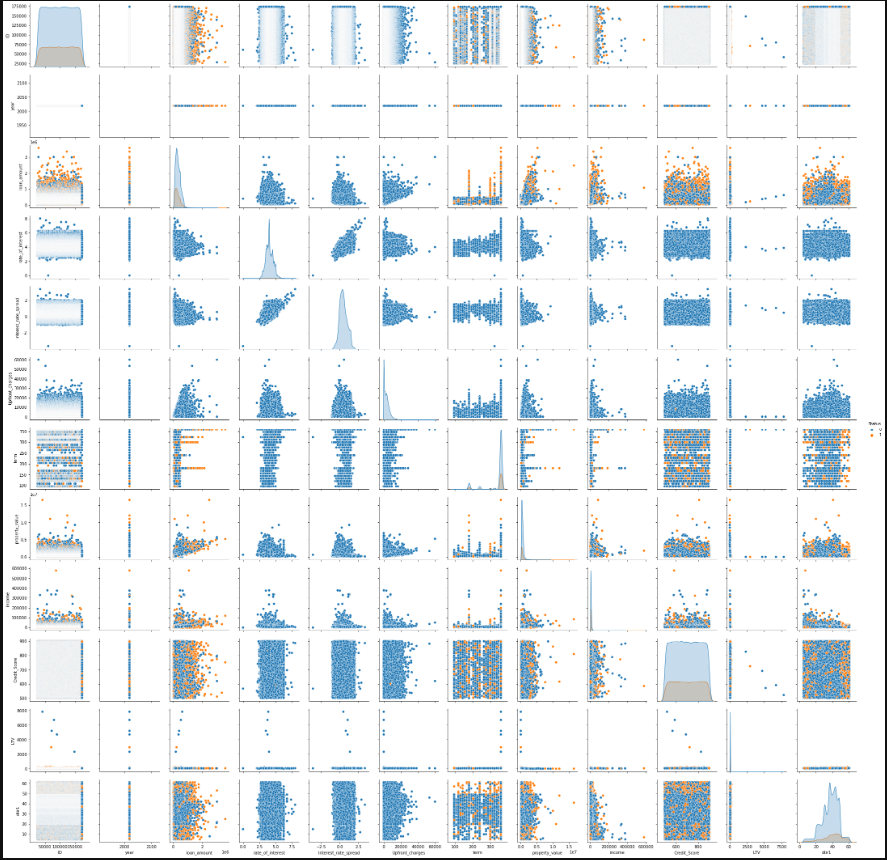
Data Exploration
Examining clustering between variables
Important to note patterns when filling in missing values
Searching for incorrect data types and formatting errors
Notes:
The most important part of this step was taking note of the patterns of the features and mistakes in the data.

Slide 8
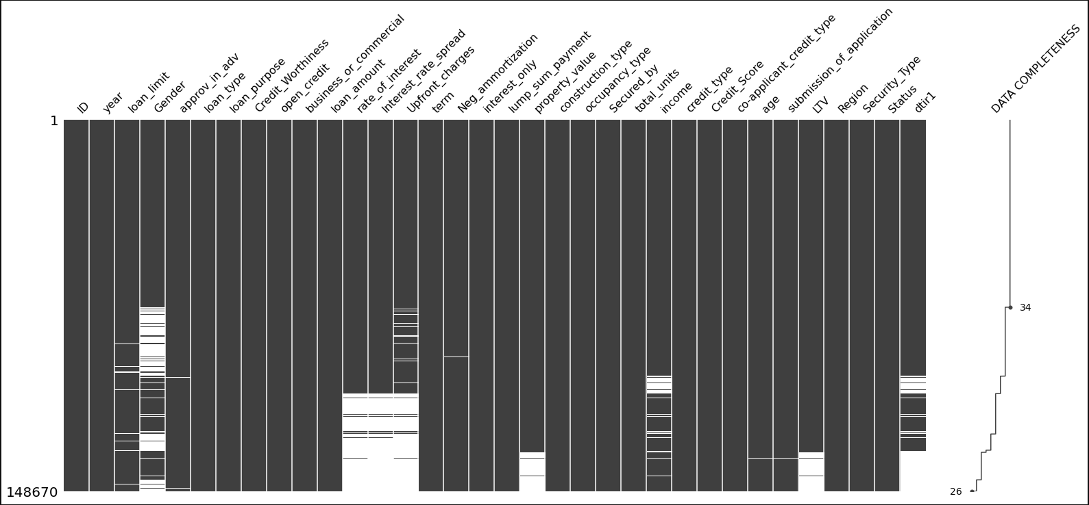
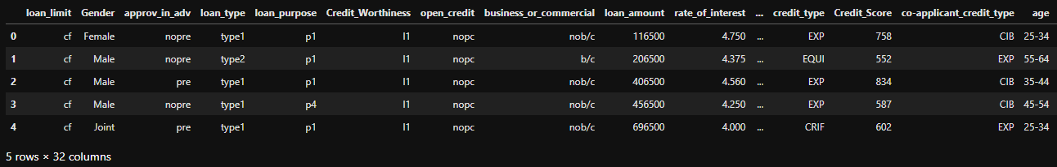
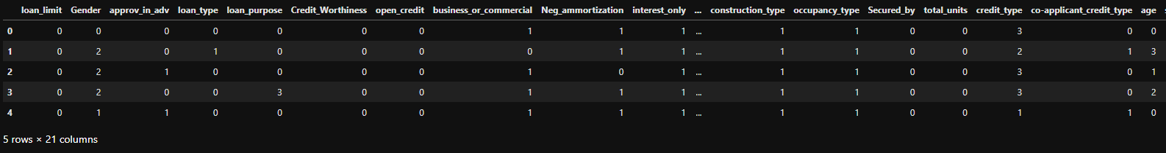
Data Preparations
Data type for Status changed to Boolean
Gender reformatted to set value [‘sex not available’] as NA
Dropped columns year and ID
Data Imputation using MiceForest method
Used Label Encoder to convert categorical features to

Slide 9
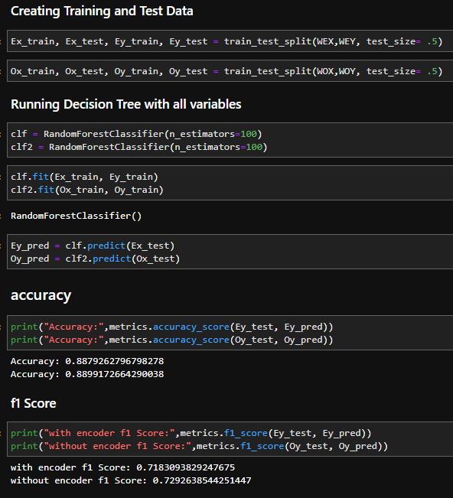

Model Prep and Training
Splitting dataset into train and test sets with 70% for training and 30% for testing
Creating the model using Sklearn’s RandomForestClassifier
This model contained all variables
Had all parameters set as default values
Created a model with 100 trees
Tested to see if one hot encoding improved model performance or not

Slide 10
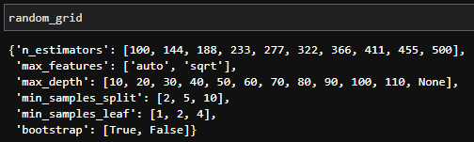
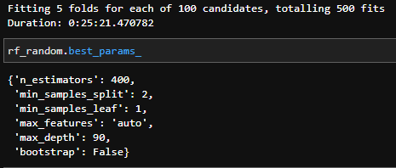
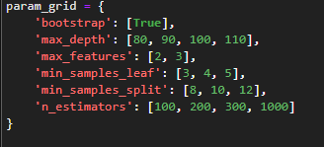
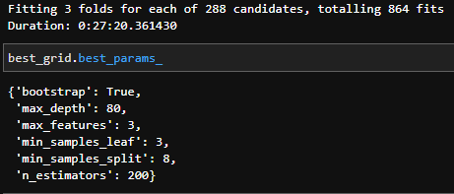
Tuning Hyperparameters
Reduced the number of features to improve accuracy and decrease computation
Used RandomizedSearchCV to reduce Hyperparameter ranges to search through
Try’s a 500 different random combinations and returns the best one
Used GridSearchCV to try all possible combinations within reduced range and return the best model
Try’s 864 different combinations and returns the best one
Randomized search used 3-fold cross validation and Grid Search used 5-fold cross validation

Slide 11
Results
Confusion Matrix:
actual
 | 0 | 1
0 | 54933 | 1009
1 | 7149 | 11244
predicted
Model Performance:
Important features:
% Contributed
Accuracy: 89.46%
F1 Score: .7386
Credit Type
Income
LTV
26.84%
8.07%
7.63%

